Slide 1
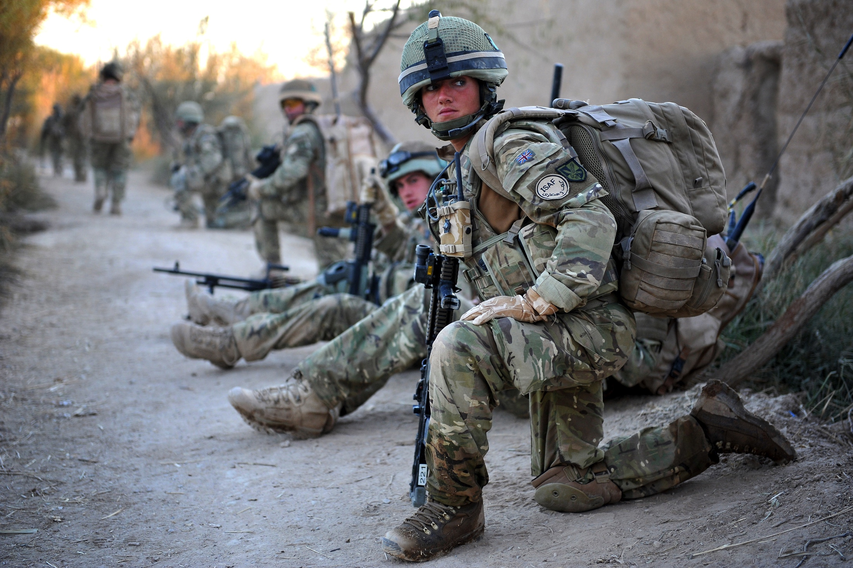

Should women be allowed to serve in equal combat roles in the Army?
Notes:
NAM. 2015-11-55-171
Digital photograph by Sgt Rupert Frere, Royal Logistic Corps.
From a collection of digital photographs compiled by Sgt Rupert Frere, Royal Logistic Corps.
Associated with Afghanistan (2001-).
Crown copyright.

Slide 2
This PowerPoint presentation contains a selection of images and archives which students can use to prompt discussion and encourage further research. The materials come from the Collection of the National Army Museum (NAM).
Unless otherwise stated in the notes, the images can be freely used for non-commercial purposes within the classroom. You can use the entire presentation or choose individual images for use in other non-commercial contexts. When using individual images in other contexts, please always retain the attribution statements provided in this document (e.g. NAM. 2005-08-66-1).
By downloading this document and using these images you agree to these terms of use, including your use of the attribution statement specified for each object by NAM.

Slide 3
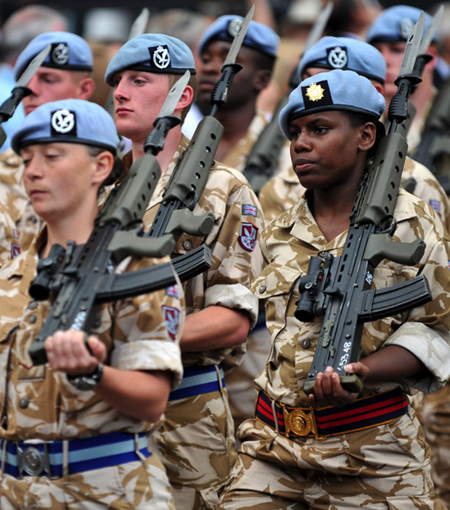
Soldiers don’t just ‘fight’
Soldiers can work in over 200 different roles in the Army.
All soldiers receive the same basic training in combat, but then they specialise.
The Army was judged one of The Times Top 50 employers for women in 2016.
Notes:
NAM. 2016-04-9-164
Digital photograph taken by Sgt Rupert Frere, Royal Logistic Corps. Crown copyright.
3 Regiment Army Air Corps (AAC) receive the award of the Honorary Freedom of Bury St Edmunds, 22 Jul 2010. Features a parade through the town and the presentation of medals by HRH The Prince of Wales, Colonel in Chief of the AAC.
Associated with Operation HERRICK, Afghanistan (2001-).

Slide 4
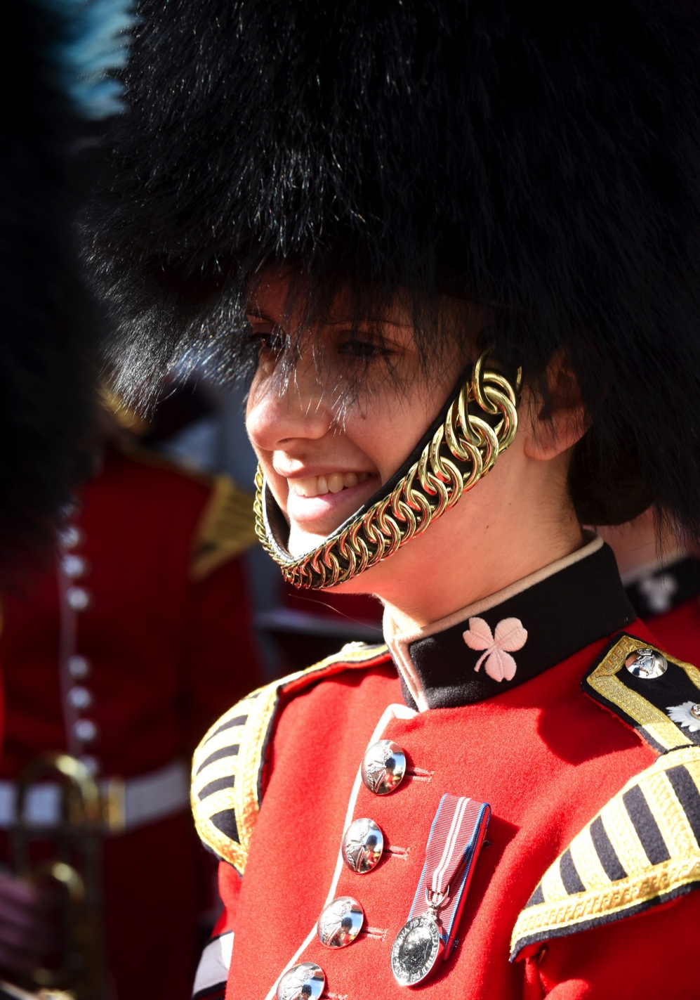
Female soldiers
Women are able to apply for ‘most’ of the roles in the Army.
They already serve on the ‘frontline’ as medics, engineers, bomb disposal officers, intelligence officers etc.
However, they CANNOT serve in ‘close ground combat’ roles.
Notes:
NAM. 2015-11-53-165
Digital photograph of a musician. She is badged to the Irish Guards. As an infantry unit, the Irish Guards is not open to women in combat roles.
From a collection of photographs compiled by Sgt Rupert Frere, Royal Logistic Corps, primarily of British Army units involved in ceremonial duties in London in 2015.
Crown copyright.

Slide 5
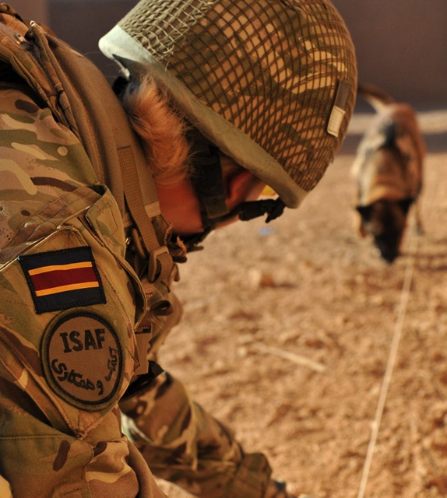
Close ground combat
The British interim review defined close ground combat as:
“…roles that are primarily intended and designed with the purpose of requiring individuals on the ground to close with and kill the enemy.”
Some other countries do not make the same distinction between male and female soldiers.
Notes:
NAM. 2013-06-15-7
Photograph of a female dog handler and her dog, searching for IEDs in Afghanistan.
From a collection of multimedia compiled by Royal Army Veterinary Corps.
Associated with Afghanistan (2001-2014).
NAM copyright.

Slide 6
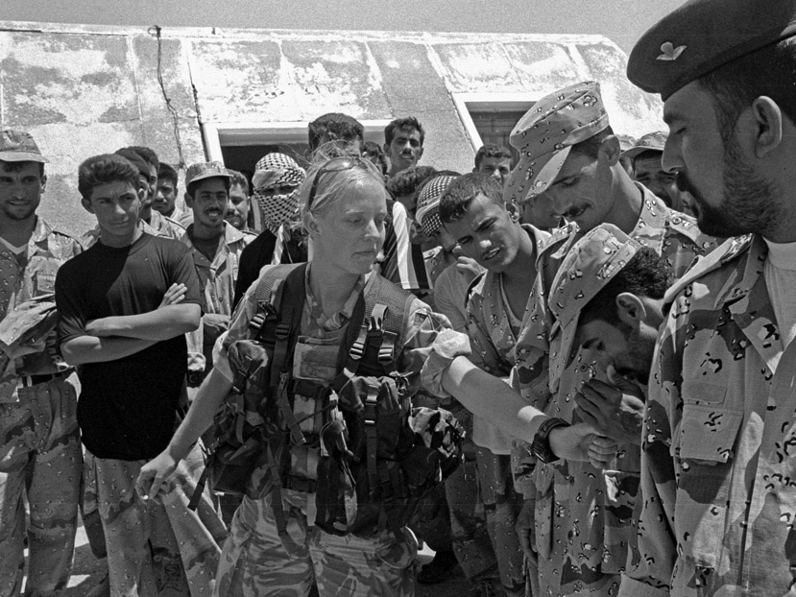
What justifications prevent women from specialising in close ground combat?
Notes:
NAM. 2005-01-67-50
Digital photograph: A female soldier serving with Y Company, The 1st Battalion, Princess of Wales's Royal Regiment, is one of a platoon of soldiers to visit a local Iraqi Police Training facility as part of on going negotiations and assistance provided to the local law enforcement.
Photographed by WO2 Giles Penfound, Army Media Operations, Al Amarah, Maysan, southern Iraq, Operation TELIC 4, 4 July 2004.
Crown Copyright.
Note from photographer: The Iraqi police were extremely hospitable and friendly and see the female members of the British unit as something of a curiosity. Perhaps because of her rarity value she became somewhat crowded by the Iraqi men to the point where I asked if she needed me to fend them off and protect her. Her reply was something like "don't worry Sir I can handle them" and indeed she did.

Slide 7
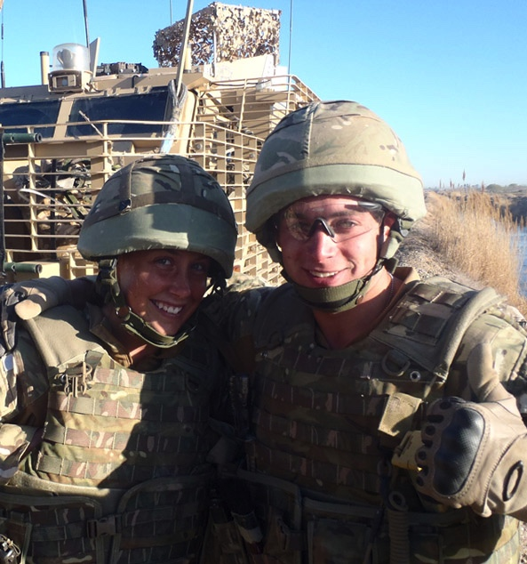
Justifications used to exclude women
Tradition and culture
Standards
Physical ability
Psychological strength
Combat effectiveness
Effects on ‘team cohesion’
Single gender units easier to organise, equip and lead
Notes:
NAM. 2013-02-13-328
A female dog handler from the Royal Army Veterinary Corps and a searcher from the Corps of Royal Engineers pose for a photograph while out on a task.
Digital photograph from a collection of 797 digital photographs and 51 digital films relating to the service of 61 Field Squadron, 33 Regiment (Explosive Ordnance Disposal), Royal Engineers, dealing with improvised explosive devices (IEDs) in Afghanistan. Associated with Operation HERRICK, Afghanistan (2001-2014) 2004- .

Slide 8
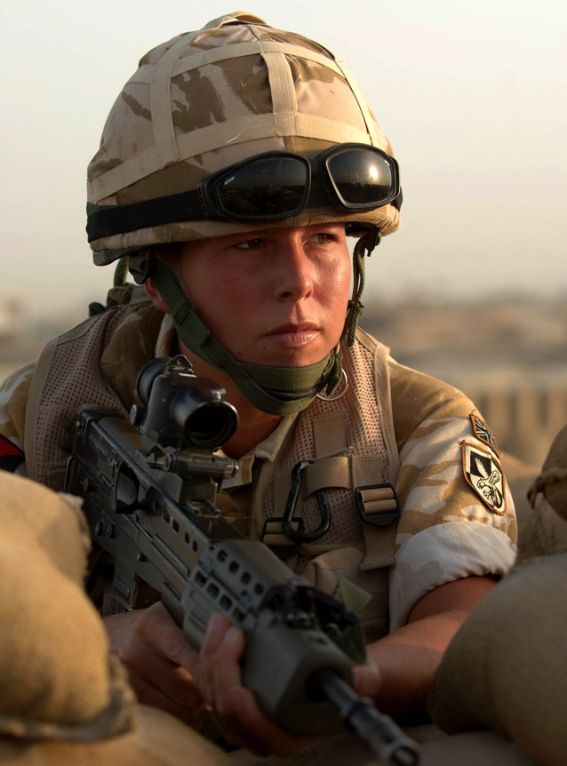
Time to change?
Brigadier Nicky Moffat, the highest-ranking woman in the British Army until her retirement in 2012 said the arguments against women in combat roles were:
“…the same that used to be trotted out to exclude women from the wider range of roles in which they are now allowed to serve.”
Source: www.bbc.co.uk
Notes:
NAM. 2006-10-3-222
Photograph: 2/Lt Hannah Bedford, Royal Logistic Corps, in a fire position at Lashkar Gah
Crown copyright.
Digital photograph taken by Cpl Mike Fletcher, Royal Logistic Corps, Helmand Task Force Photographer, Helmand Province, Afghanistan, 10 Aug 2006. From a CD of 309 images.
2/Lt Hannah Bedford, 22, 13 Air Assault Brigade, Royal Logistic Corps, from Reading. 2/ Lt Bedford and her brother, 2/Lt Simon Bedford, 24, 3rd Battalion Parachute Regiment, were both on tour in Afghanistan on Operation HERRICK IV.
This image was taken on Operation HERRICK IV, the UK's deployment into Helmand Province, Southern Afghanistan. Operation HERRICK IV has seen the development of the Helmand Task Force in the province, which has seen the cross Governmental Provincial Reconstruction Team set up in Lashkar Gah to help the Afghan Government build strong governmental institutions, security and create jobs. The Task Force was made up of 3,300 troops from the British Military, with the majority being taken from 16 Air Assault Brigade.

Slide 9
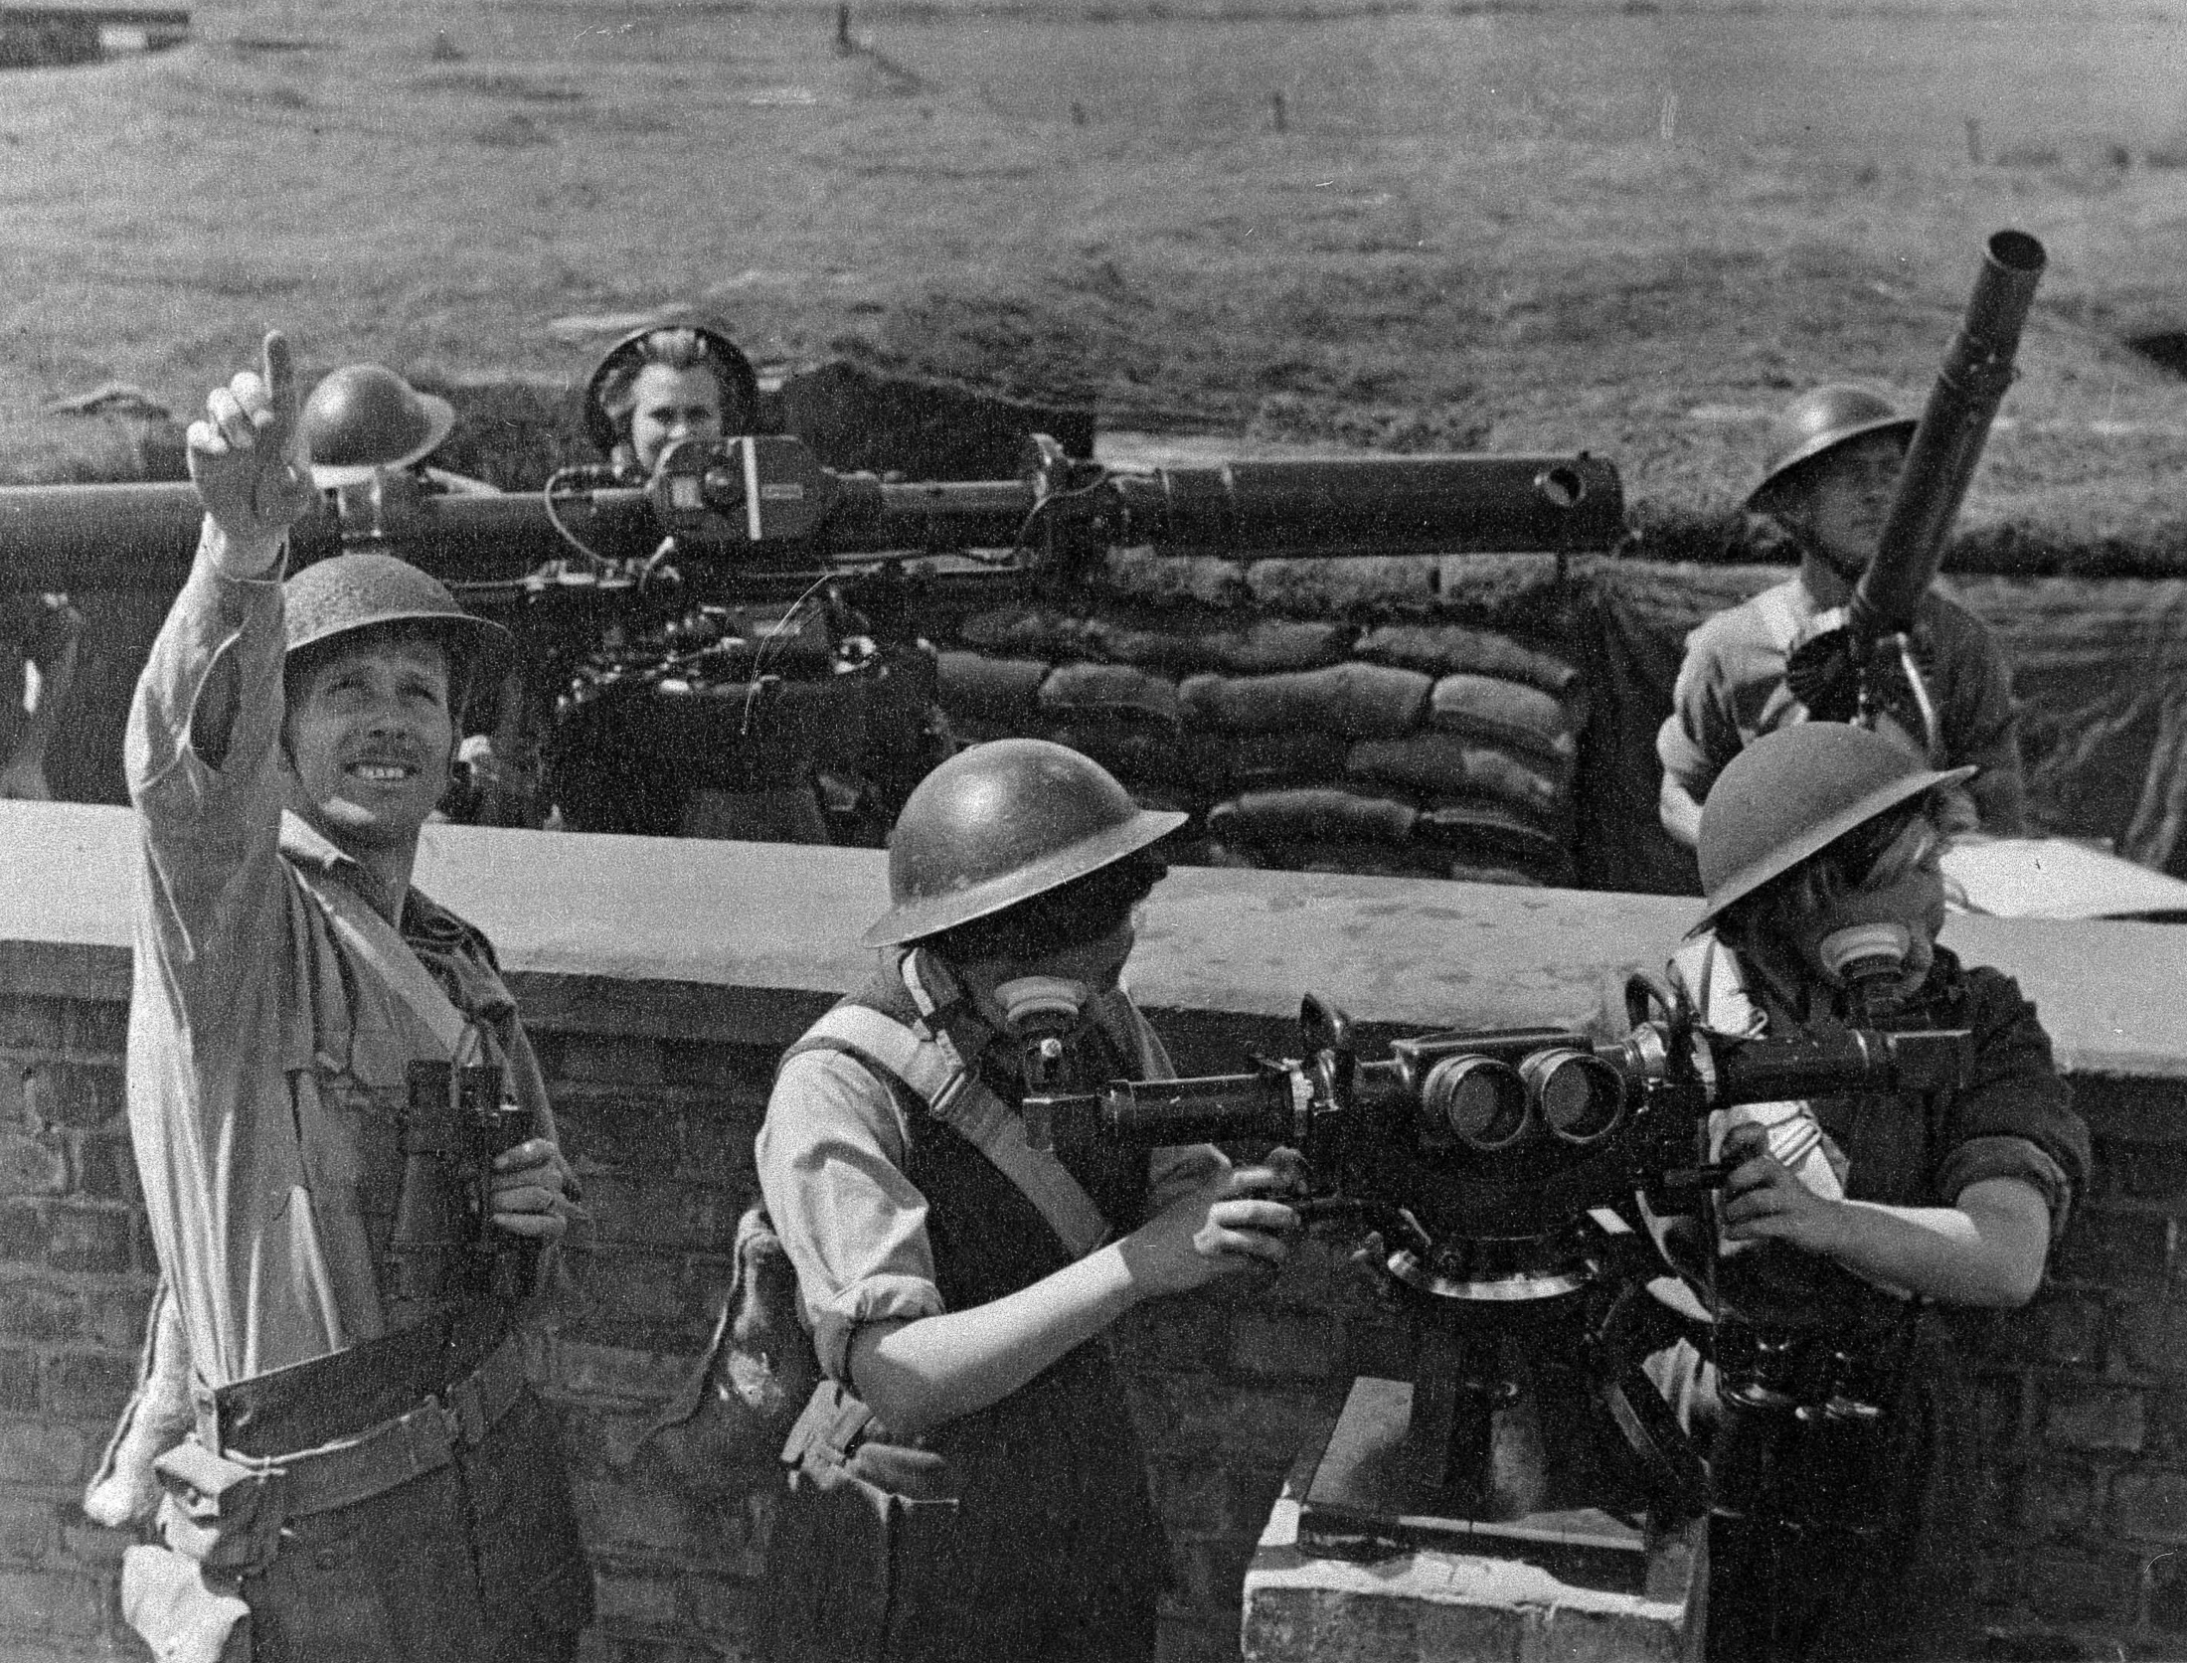
How has the role of women in the Army changed over time?
Notes:
NAM. 1994-07-279-84
Photograph of women operating predictors and range finders on an anti-aircraft battery. The man to the rear of the picture is operating the light machine gun.
This photograph is one of 68 showing technical scenes associated with Auxiliary Territorial Service personnel, including the operation of predictors, range finders, height-fighters, sound detectors, kine-theodolites, search lights and the control room, 1939-1945.
From a collection of 300 photographs relating to the role played by Auxiliary Territorial Service personnel in anti-aircraft operations and as Experimental Gunnery Assistants.

Slide 10
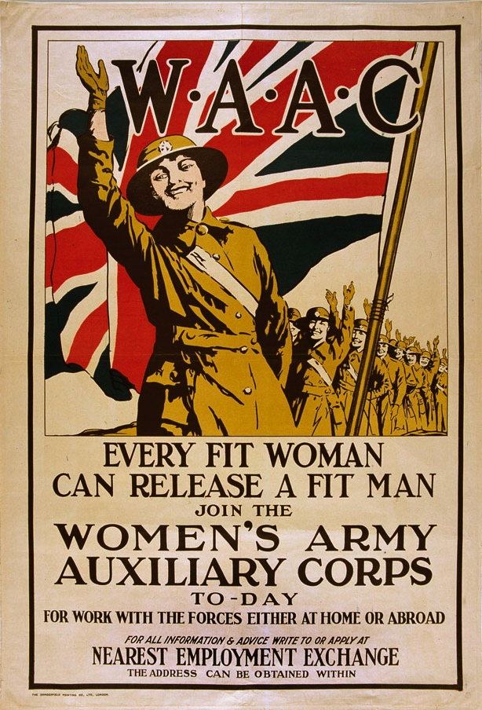
First women in the Army – the WAAC
In 1917, as the First World War drained Britain’s manpower, the Women’s Army Auxiliary Corps (WAAC) were formed.
Women volunteered to carry out a number of jobs which up until then had been performed by male soldiers. These men could then be released for combat roles.
Notes:
NAM. 1993-11-1-110
W.A.A.C. Every Fit Woman Can Release a Fit Man. Join the Women’s Army Auxiliary Corps To-day.
Recruiting poster, Women’s Army Auxiliary Corps, 1918.
Colour photolithograph, artist unknown, printed by Dangerfield Printing Co Ltd, 1918.
Associated with World War One, Home Front (1914-1918).

Slide 11
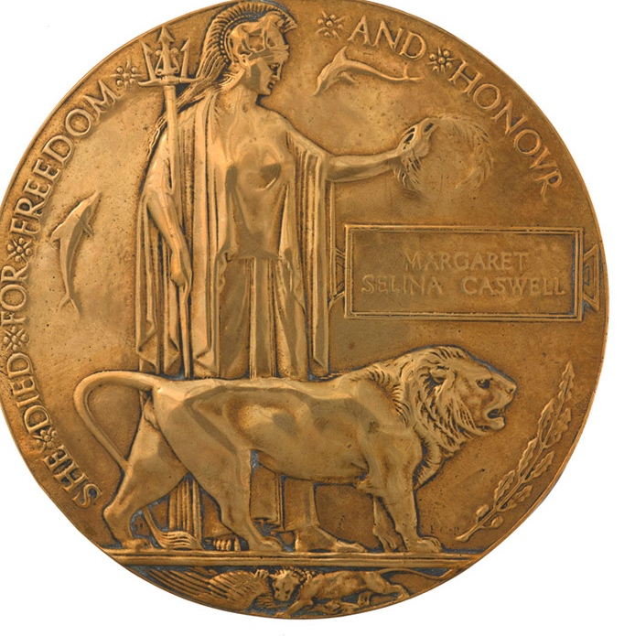
Equality?
Women were paid less than a man doing the same work.
The WAAC also shared some of the dangers of their male colleagues. Air raids on the camps and depots were frequent and in one, on 30 May 1918, nine women died in an air raid, with six wounded.
Notes:
NAM. 1998-02-164-2
Commemorative Medallion 1914-1918.
Awarded to Margaret Selina Caswell, Women’s Legion, Women’s Army Auxiliary Corps and Queen Mary’s Army Auxiliary Corps, and issued to her next of kin.
Associated with World War One, Western Front (1914-1918).
Caswell was among nine women who died in an air raid at Abbeville in France on 30 May 1918.

Slide 12
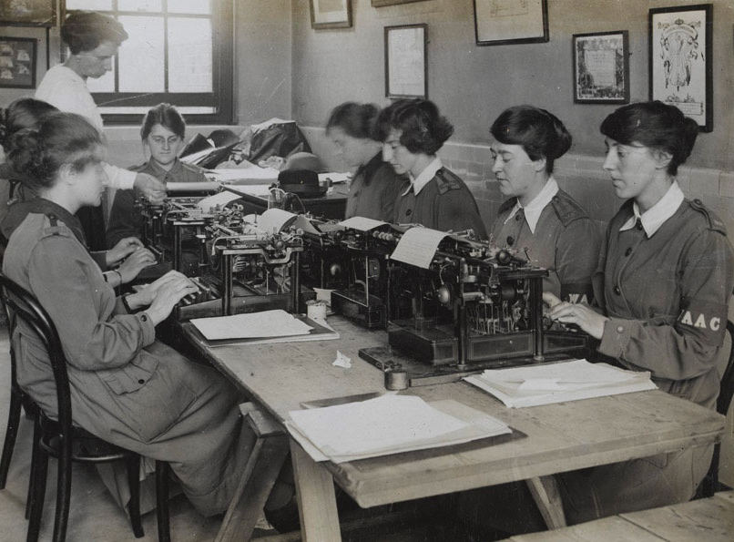
What were public opinions of women’s service?
Notes:
NAM. 1995-01-23-3
Photograph of WAACs typing.
From album containing 55 photographs relating to the Women’s Army Auxiliary Corps, 1917-1918.
Associated with World War One (1914-1918).

Slide 13
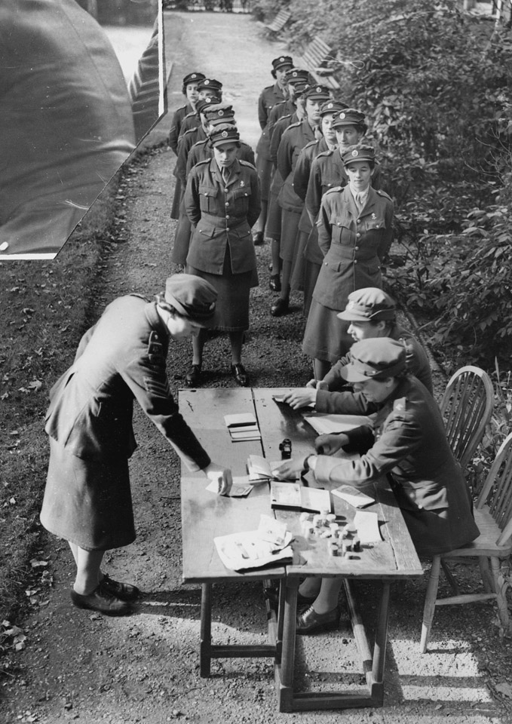
The ATS
The Auxiliary Territorial Service (ATS) was formed in 1938.
Women were conscripted for war service from December 1941.
“In April 1941, the members of the ATS were given full military status, although they continued to be paid two-thirds of the wage of a man of the same rank”.
Source: www.bbc.co.uk
Notes:
NAM. 1995-01-46-55
Members of the ATS waiting in their pay parade.
From photograph album containing 103 photographs with newspaper cuttings and ephemera relating to the Auxiliary Territorial Service and the Women’s Royal Army Corps, Territorial Army 1939-1951.

Slide 14
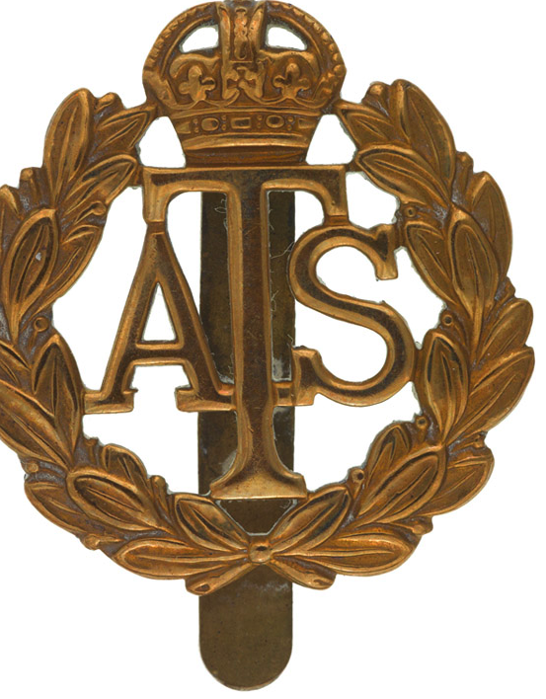
Women Conscripts
Women were given a choice of working in industry or the armed forces. They could choose from the ATS or its naval or air force equivalents.
Initially the only jobs available were cooks, clerks, orderlies, store-women or drivers.
Eventually the range of duties carried out by the ATS expanded, including serving in anti-aircraft batteries.
Notes:
NAM. 2009-06-9-2
Cap badge, Auxiliary Territorial Service, worn by Maj Eleanor Joan White, 1939-1951.

Slide 15
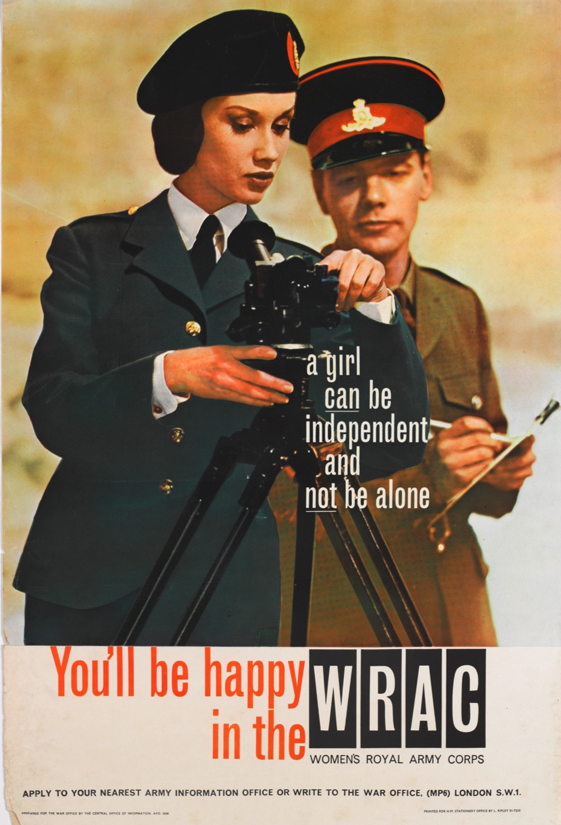
The WRAC
Between 1949 and 1992 all women in the British Army joined the Women’s Royal Army Corps (WRAC). The only exceptions were those in medical service.
First the WRAC’s role was administrative support tasks.
Later women were attached to other units including the Royal Artillery and the Royal Engineers.
Notes:
NAM. 1993-11-1-133
A girl can be independent and not be alone You’ll be happy in the WRAC.
Recruiting poster, Women’s Royal Army Corps, 1960 (c). Colour photolithograph, artist unknown, published by the War Office, 1960 (c).

Slide 16
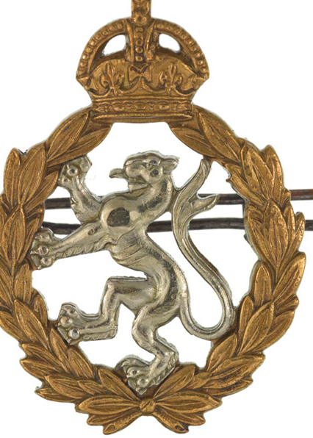
The WRAC
In April 1992, the WRAC was disbanded and the members were transferred into ‘appropriate’ units in the Army.
This has not meant that all units of the Army are open to women.
Notes:
NAM. 1980-06-95-4
Other ranks’ cap badge, Women’s Royal Army Corps, 1949-1952.
Gilding metal. A laurel wreath surmounted by a monarchial crown. Within the wreath a pierced white metal lioness rampant facing dexter. Reverse bears two copper loops and a split pin fitting.

Slide 17
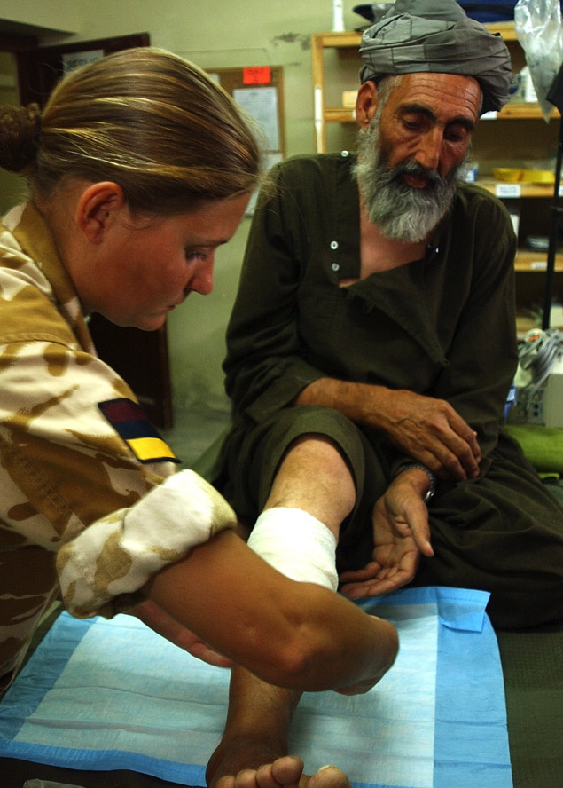
Equal Opportunities
The Equality Act 2010 makes it an offence to discriminate on the grounds of a person’s gender.
At present this doesn’t apply to the Army.
The Army is currently considering its position…
Notes:
NAM. 2006-10-3-15
Photograph: A medic renewing the dressing on an injured man’s leg.
Digital photograph taken by Cpl Mike Fletcher, Royal Logistic Corps, Helmand Task Force Photographer, 24 May 2006, Lashkar Gah, Helmand Province, Afghanistan.
A local Afghan returned to the medical facility at Lashkar Gah to have his wound re-dressed and checked. The local man was injured during an incident outside the British compound at Lashkar Gah. The medical personnel changed the dressing and the doctor inspected the injury, all was said to be coming along nicely. The medical facility is run by members of 16 CS Med Regt, 16 Air Assault Bde, based in Colchester.
This image was taken on Operation HERRICK IV, the UK's deployment into Helmand Province, Southern Afghanistan. Operation HERRICK IV has seen the development of the Helmand Task Force in the province, which has seen the cross Governmental Provincial Reconstruction Team set up in Lashkar Gah to help the Afghan Government build strong governmental institutions, security and create jobs. The Task Force was made up of 3,300 troops from the British Military, with the majority being taken from 16 Air Assault Brigade.
Crown Copyright

Slide 18
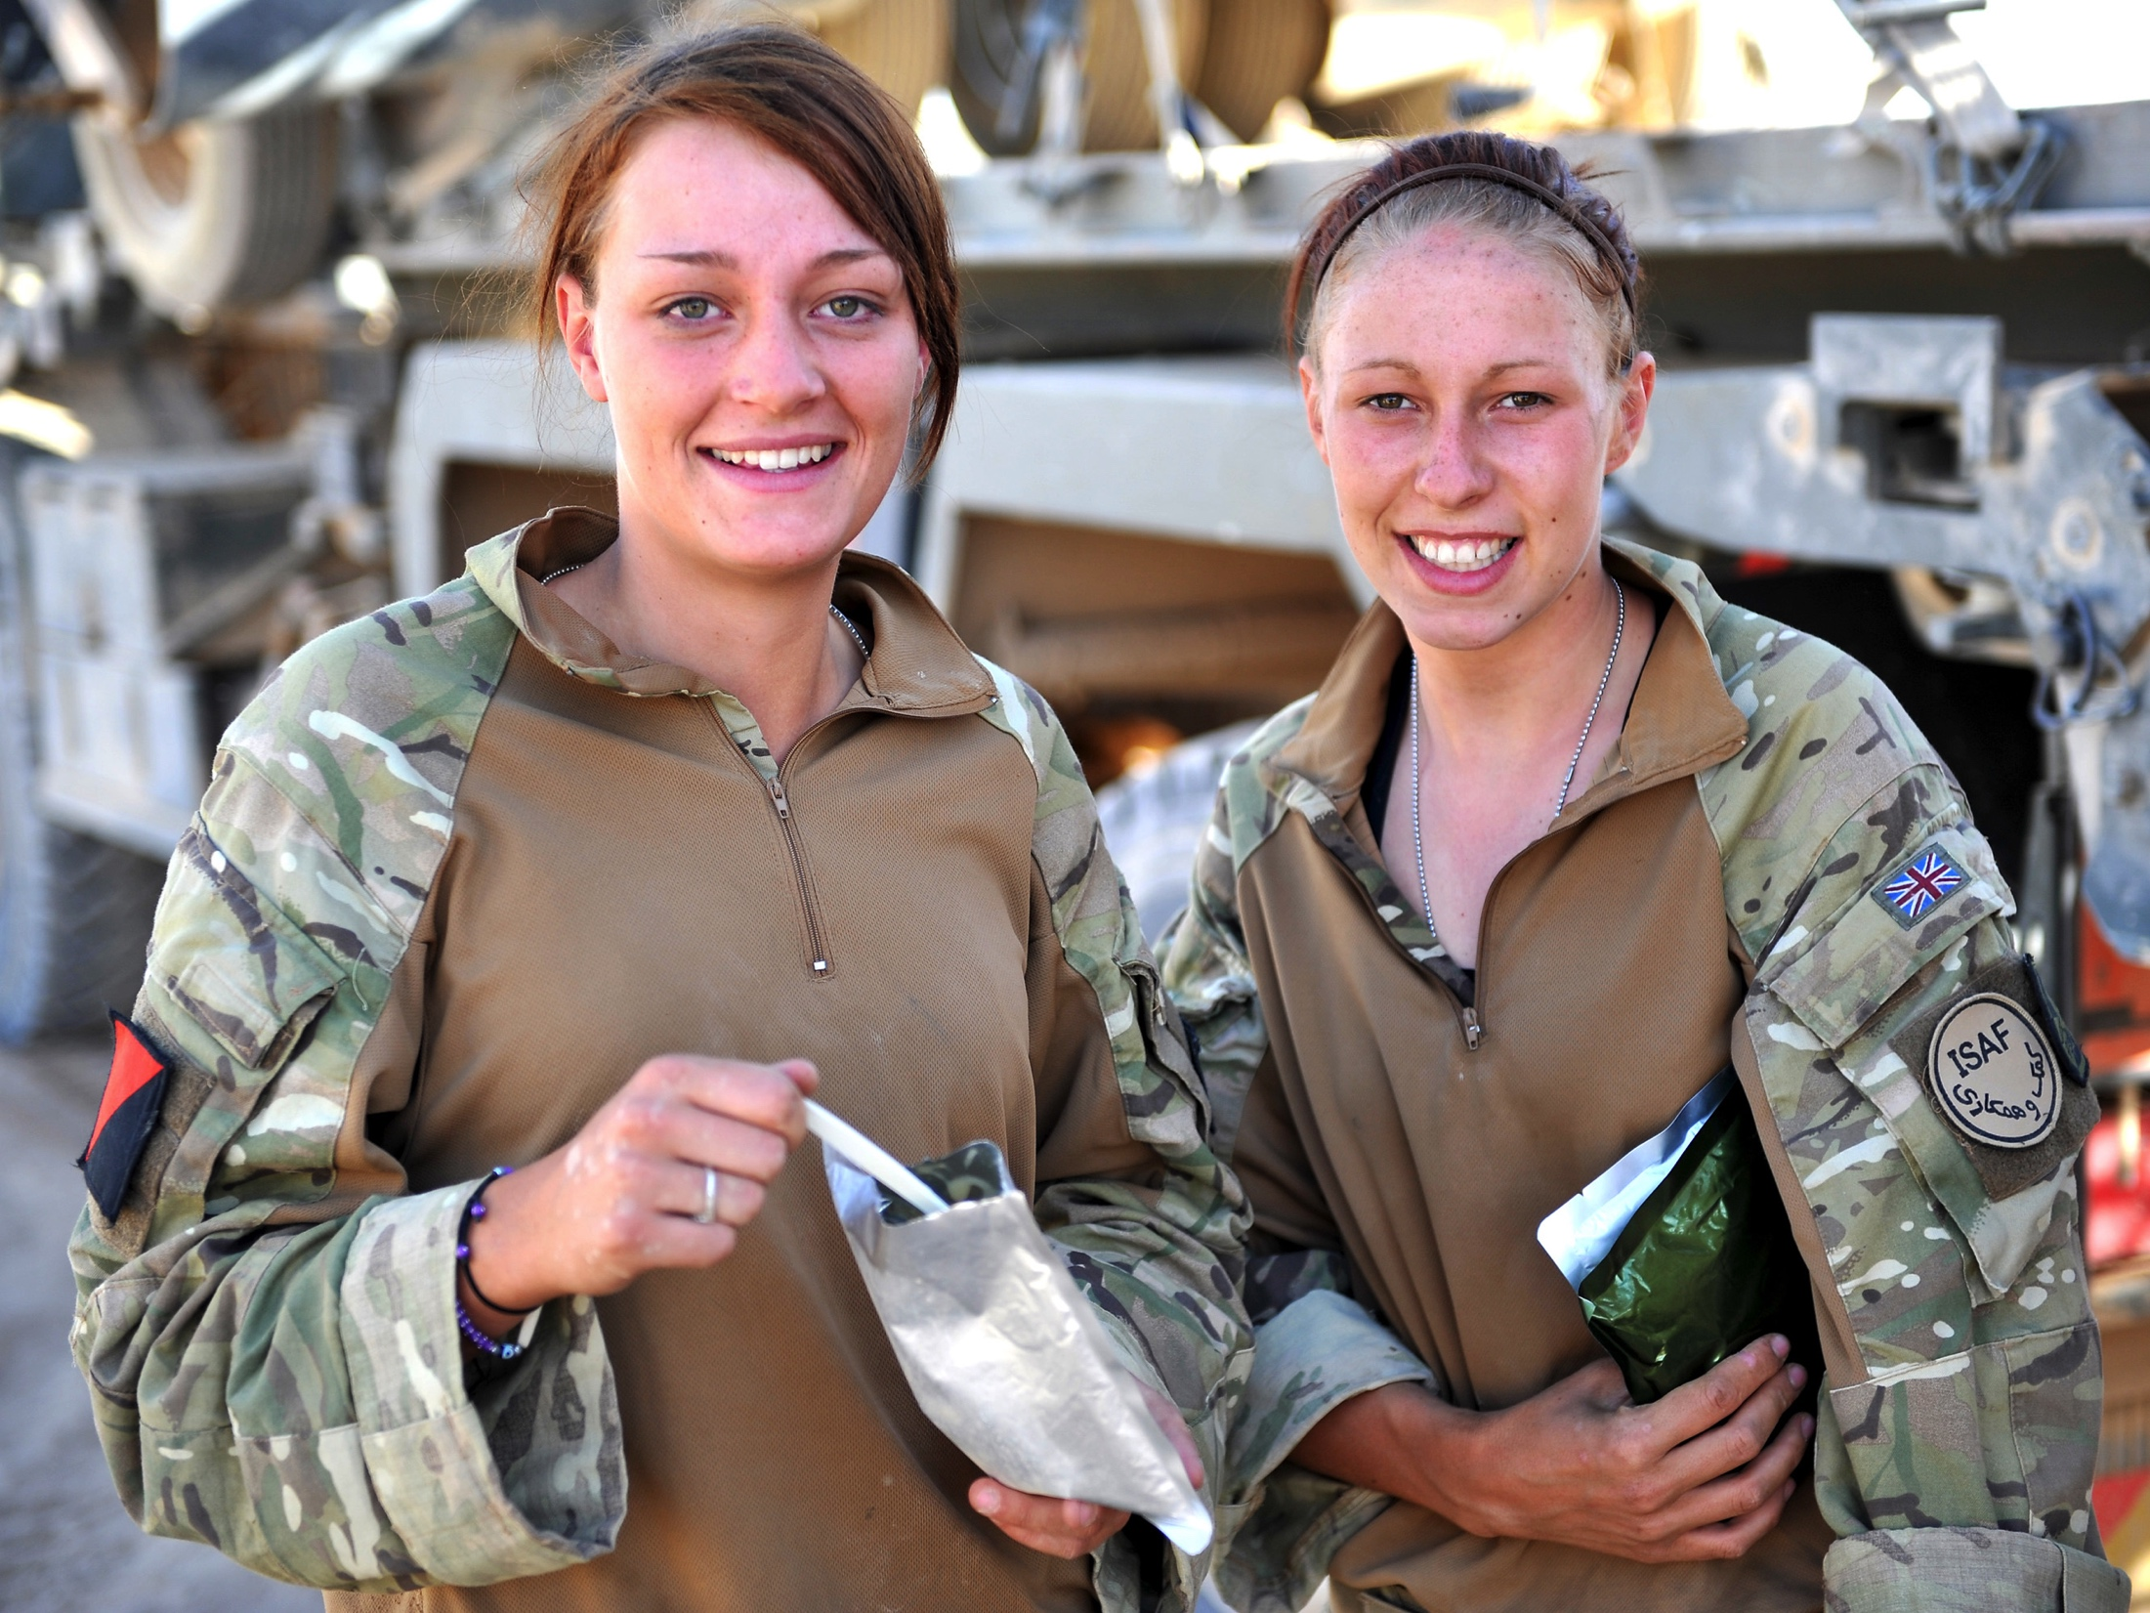
Is there a clear case for equality within the Army?
Notes:
NAM. 2015-11-55-55
Digital photograph by Sgt Rupert Frere, Royal Logistic Corps.
From a collection of digital photographs compiled by Sgt Rupert Frere, Royal Logistic Corps.
Associated with Afghanistan (2001-).
Crown copyright.

Slide 19
Take a view…
Should women be allowed to serve in equal combat roles in the Army?
Notes:
NAM. 2015-11-55-171
Digital photograph by Sgt Rupert Frere, Royal Logistic Corps.
From a collection of digital photographs compiled by Sgt Rupert Frere, Royal Logistic Corps.
Associated with Afghanistan (2001-).
Crown copyright.

