Slide 1
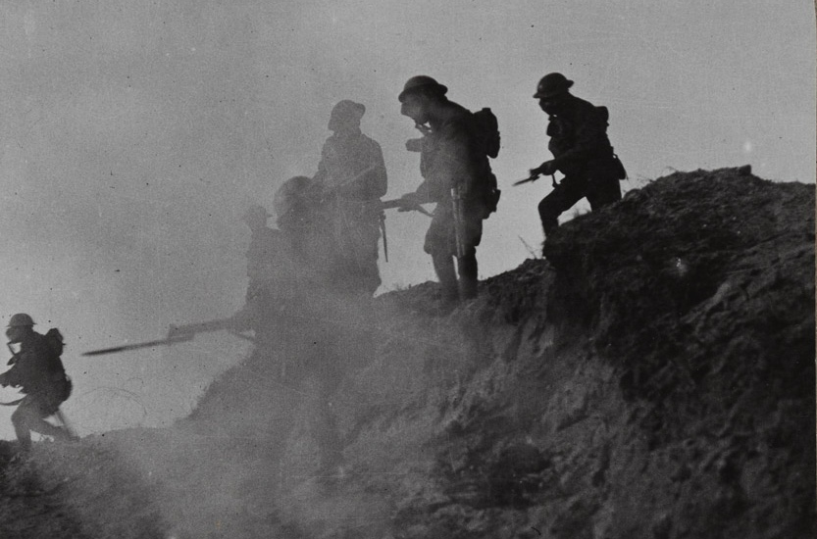

Is it right for your country to make you fight?
Notes:
NAM 1972-08-67-1-48
Stereoscopic photograph, Under cover of gas and smoke we break through to Serre and Thiepval (photo from captured prisoner), nd.
From a collection of one hundred and one stereoscopic photographs in box one of two entitled ‘The Great War’ including the official series.
Associated with World War One, Western Front (1914-1918).
Crown copyright.

Slide 2
This PowerPoint presentation contains a selection of images and archives which students can use to prompt discussion and encourage further research. The materials come from the Collection of the National Army Museum (NAM).
Unless otherwise stated in the notes, the images can be freely used for non-commercial purposes within the classroom. You can use the entire presentation or choose individual images for use in other non-commercial contexts. When using individual images in other contexts, please always retain the attribution statements provided in this document (e.g. NAM. 2005-08-66-1).
By downloading this document and using these images you agree to these terms of use, including your use of the attribution statement specified for each object by NAM.

Slide 3
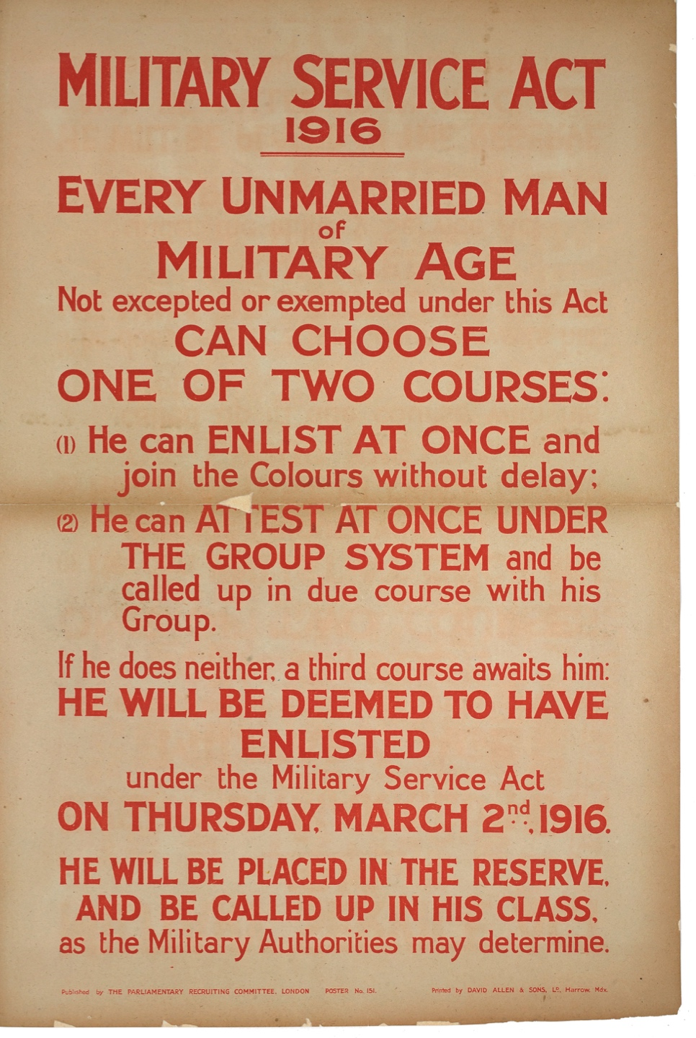
Deemed to have enlisted
Before 1916, the British governments had considered conscription an ‘infringement of liberties’.
However, the Military Service Act passed in 1916 meant that all single men from 18-41 were automatically categorised as enlisted.
Notes:
NAM 2014-07-31-1
Military Service Act 1916.
Lithographic posted published by the Parliamentary Recruiting Committee, No 151, 1915 (c).
Printed by David Allen and Sons, nd.
Associated with World War One (1914-1918).

Slide 4
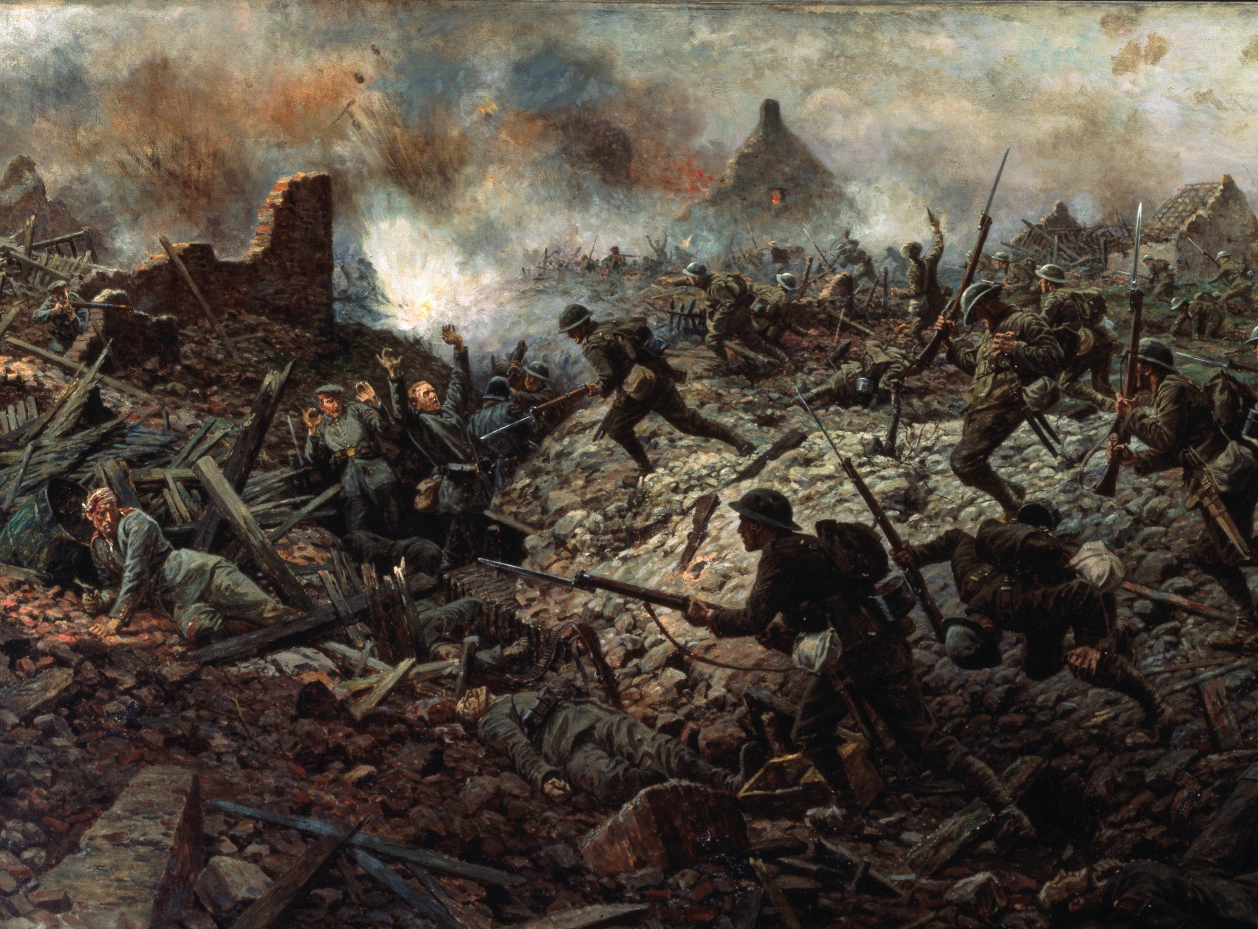
What reasons were given for introducing conscription?
Notes:
NAM 1959-11-303
The London Territorials at Pozières, 23 July 1916
Oil on canvas, signed and dated lower left 'W B Wollen 1917', exhibited at the Royal Academy 1917 No. 198, by William Barns Wollen (1857-1936), 1917
Out of copyright.
Out of copyright.
From 17 July 1916, during the Battle of the Somme (1 July to 18 November 1916), the village of Pozières on the main road running north from Albert to Bapaume, was on the front line. It was attacked on 23 July by 1st Australian Division, supported by the British Territorial battalions of the 145th Infantry Brigade. The position was taken, but with heavy losses.
From early 1916, with the German effort ‘to bleed France white’ at Verdun consuming French reserves, it fell mainly to British and Commonwealth forces to hold the Western Front. On 24 June British artillery launched a week-long intensive bombardment of the German lines north of the river Somme, in preparation for a big infantry attack on 1 July. However, when the attack was duly launched, it was found that the shelling had been largely ineffective. Twenty thousand Allied soldiers were killed, the greatest loss of Allied troops ever suffered on one day.
Despite the appalling casualties and traumatic experiences of his troops, the British commander-in-chief, General Sir Douglas Haig, continued his tactic of bombardment against the Germans. The campaign deteriorated into a series of minor but very costly actions. In September tanks were employed for the first time to cross trenches and destroy machine guns, but they were unreliable and too few to help secure outright victory.
The Somme offensive cost the Allies some 420,000 casualties: the Germans had even greater losses. During these months the Allies advanced barely eight miles.

Slide 5
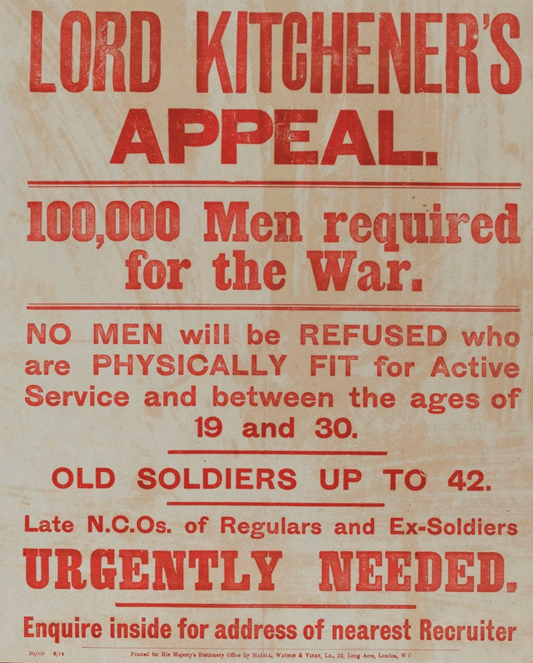
Why conscription?
Lord Kitchener’s campaign had encouraged over one million men to enlist by January 1915. But this was not enough to keep pace with mounting casualties.
“Parliament was deeply divided but recognised that because of the imminent collapse of the morale of the French army, immediate action was essential.”
Source: www.parliament.uk
Notes:
NAM 1996-01-10-1
Poster: Lord Kitchener’s Appeal.
Recruiting poster published by His Majesty’s Stationery Office, August 1914, calling for 100,000 men to join the Army.
Associated with World War One 1914-1918.
While many expected the war to be 'over by Christmas’, the Secretary of State for War, Field Marshal Lord Kitchener, realised the conflict would be long and on an unprecedented scale. Britain would have to create a mass army for the first time. He appealed for volunteers for his ‘New Armies’ in August 1914. Recruitment officers were sent to towns, cities, factories and clubs. Propaganda posters were placed all over the country to persuade men to sign up.

Slide 6
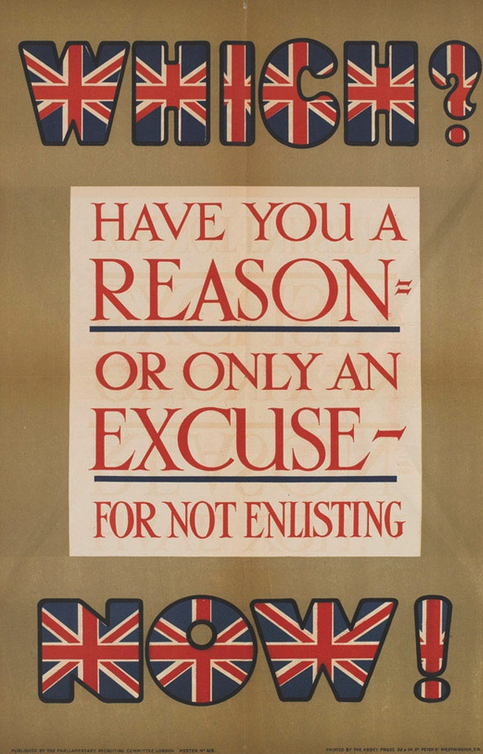
Exemptions to conscription… part 1
Married men
Exempt until the Act was extended in 1916
Age restriction
  During the last months of the war, the Military Service Act (No. 2) raised the age limit to 51
Reserved Occupation
  Workers in roles essential to the wider effort – e.g. teachers, miners, farmers – were not selected, and could be barred from volunteering
Notes:
NAM 2012-08-1-3
Which? / Have you a/ reason -/ or only an excuse -/ for not enlisting now!
Typographical chromolithograph recruiting poster, 1915.
Printed by The Abbey Press 32 and 34 Great Peter Street, Westminster, S.W., 1915.
Published by The Parliamentary Recruiting Committee, London, poster no. 128, 1915 (c).
Shows a typographical poster, some of the letters decorated with Union Flags.

Slide 7
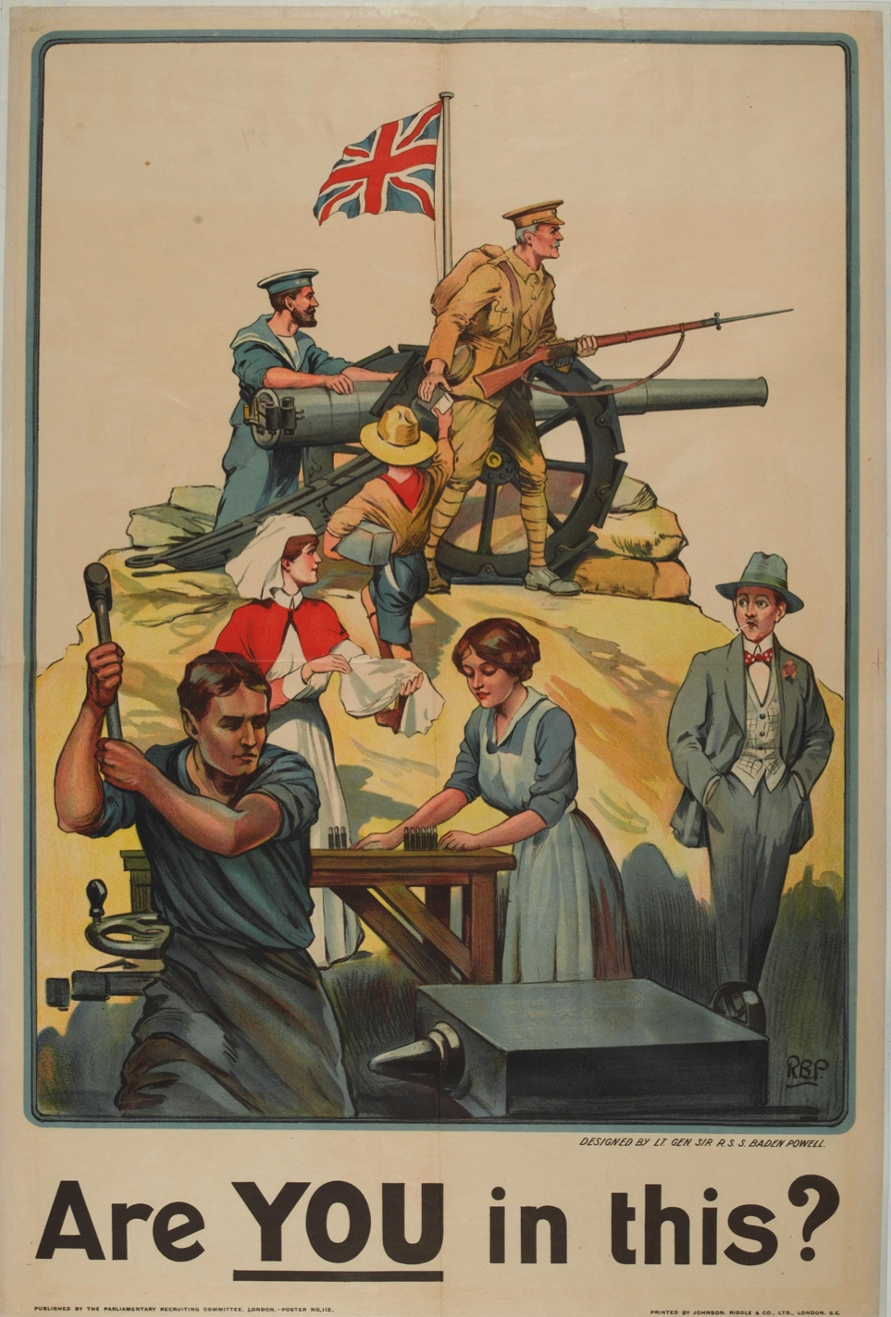
Exemptions to conscription… part 2
Ill-health
Widowed with children
Ministers of religion
Conscientious objection
  Men who objected to fighting on religious or moral grounds. They could be given civilian work, or non-fighting roles on the front. Some were refused the right to conscientious objection, and then were deemed to have deserted
  Women
Notes:
NAM 1977-06-81-29
Recruiting poster, ‘Are You in this?’, 1915
Chromolithograph after Lt Gen Sir R S S Baden-Powell, poster No 112 published by Parliamentary Recruiting Committee, printed by Johnson, Riddle and Company, London, July 1915.
Talented artist, writer, former soldier, and founder of the Scout Movement, Sir Robert Baden-Powell designed this poster to remind people there were many ways in which they could contribute to the war effort. It depicts a civilian watching the patriotic activities of a sailor, a soldier, a boy scout, a nurse, and male and female munitions factory workers.

Slide 8
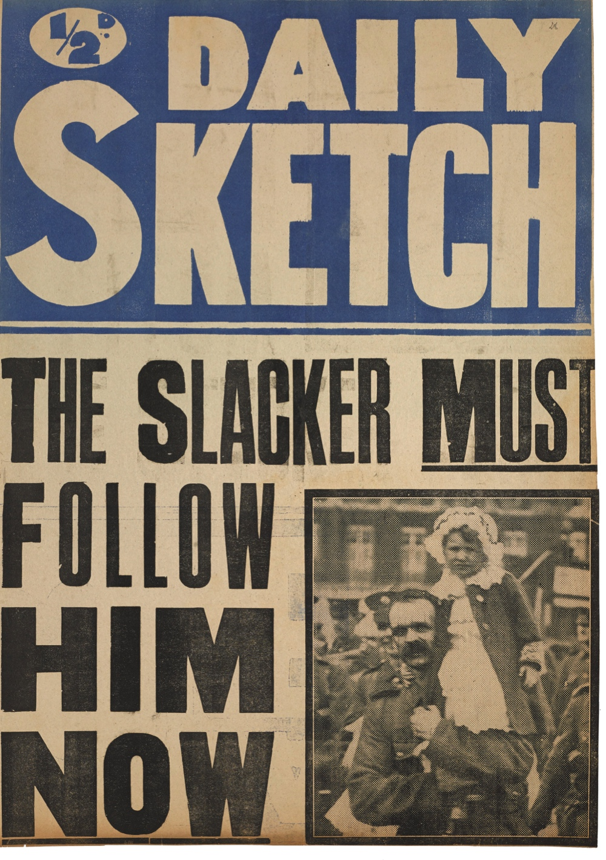
Reactions to conscription
In April 1916 over 200,000 demonstrated against it in Trafalgar Square
Some thought it was time the ‘slackers’ did their bit
Conscript soldiers served alongside volunteer soldiers for the remainder of the war
Notes:
NAM 2014-07-37-1
Daily Sketch, The Slacker MUST Follow Him NOW.
Printed news-stand poster, with photographic insert of soldier holding a child, 1916 (c).
Associated with World War One (1914-1918).

Slide 9
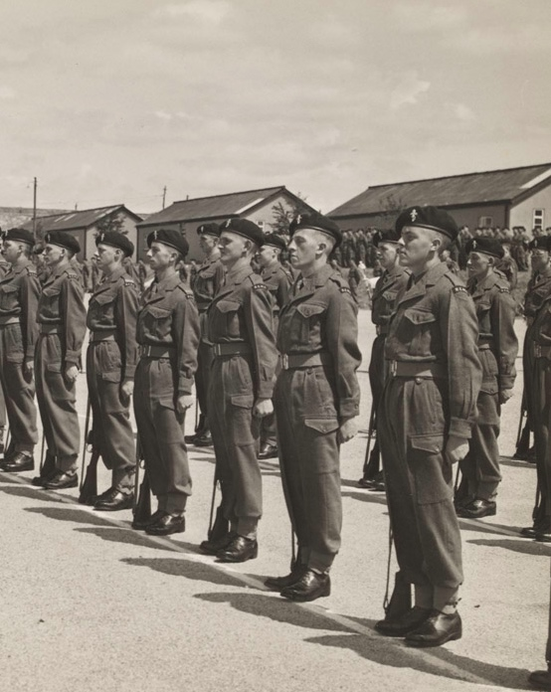
But once introduced…
Compulsory National Service was reintroduced before the Second World War even started and continued long after the war, until 1960.
Although not in force now, a reintroduction of National Service is still debated in the press and parliament from time to time.
Notes:
NAM 2002-11-660-1
The passing out parade of C Coy, Royal Electrical and Mechanical Engineers, Honiton Camp, Devon, 24 Jun 1952.
From a photograph album relating to the National Service of John Heygate with the Royal Electrical and Mechanical Engineers, 1952-1954, including service in the Canal Zone.

Slide 10
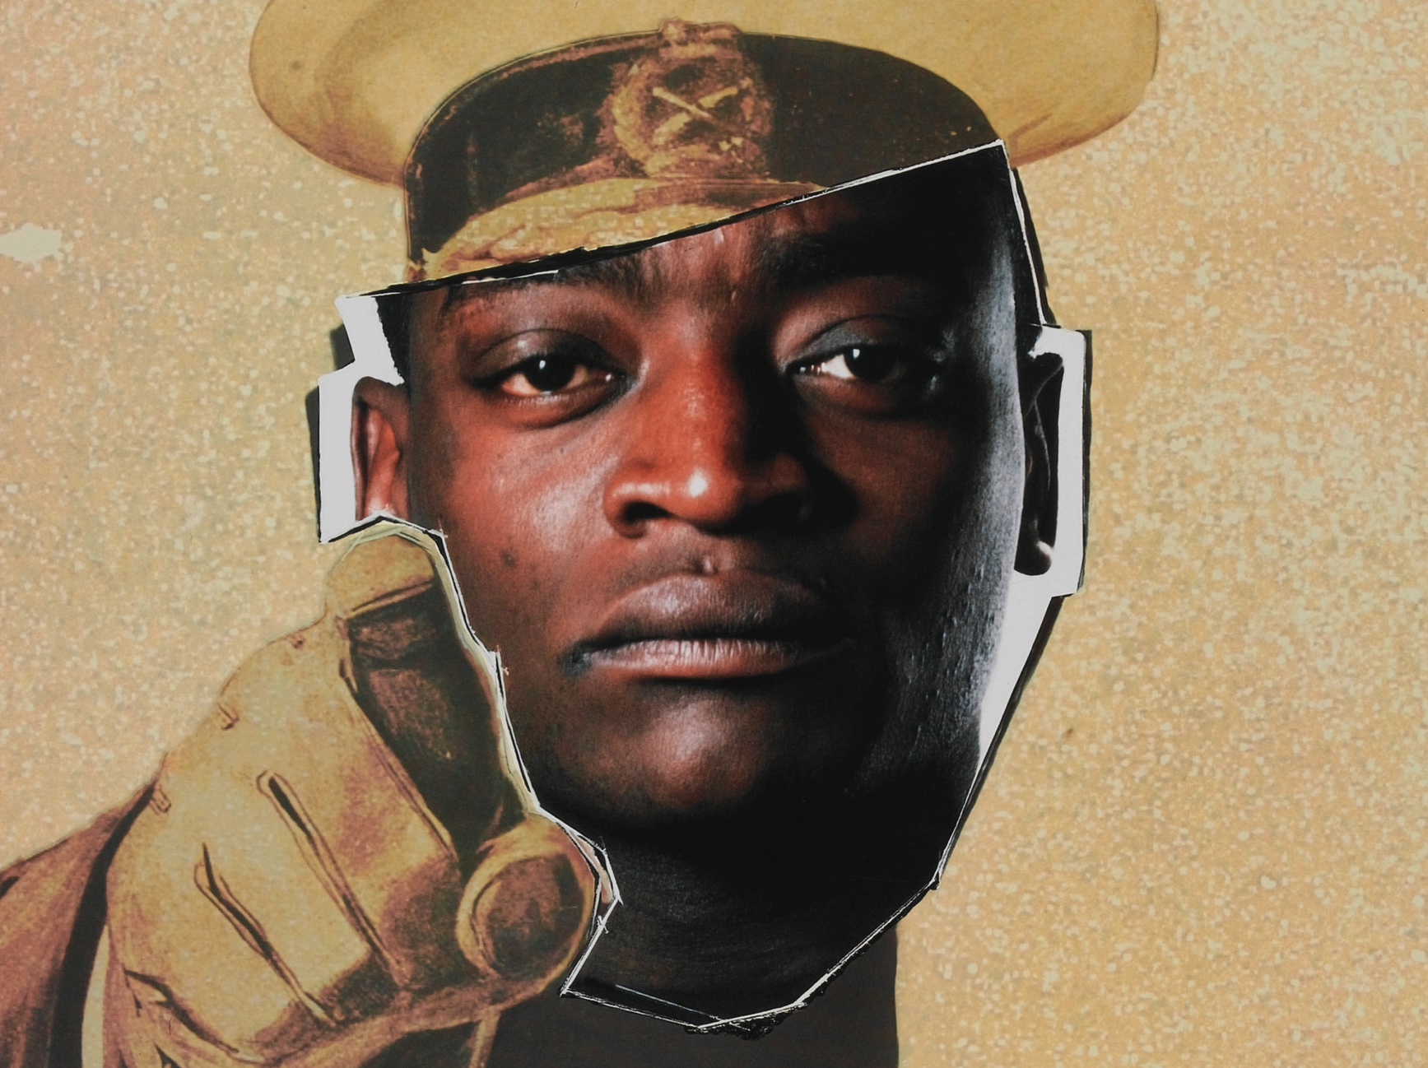
Should compulsory military service be reintroduced?
Notes:
NAM 1998-10-244-1
Your Country Needs You, 1998 (c).
Crown copyright.
Detail from Colour photolithograph recruiting poster to encourage ethnic minorities to join the Army, published by the Ministry of Defence, 1998 (c).
During the early 1990s, the Army's public image was tarnished by reports of bullying and abuse of black soldiers. In 1997, the Office of Public Management released a damning report that found evidence of widespread racism in the armed forces. In response, the Ministry of Defence launched its first-ever campaign aimed specifically at recruiting ethnic minority officers. This included the issuing of a new set of recruitment posters based on Alfred Leete’s well known ‘Your Country Needs You’ poster of Lord Kitchener from the First World War. In this example, Kitchener’s face has been replaced by that of Ghanian-born Captain Fidelix Datson of the Royal Artillery.

Slide 11
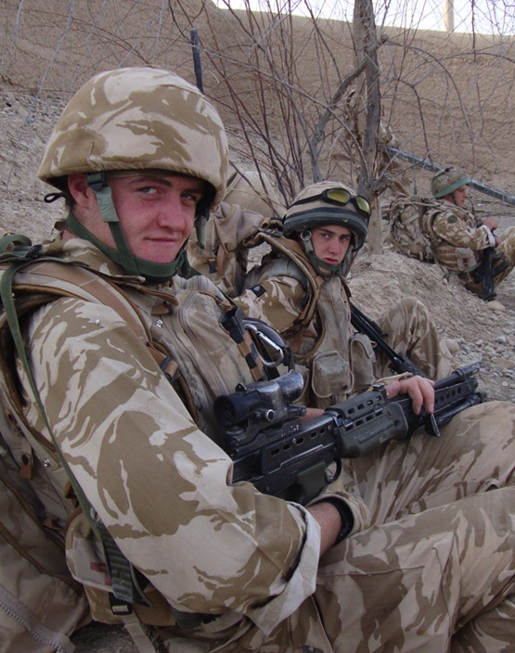
Arguments made FOR
An educational experience
Teaches self-discipline required to succeed in education or work
A solution to a perceived lack of discipline and engagement in society among young people. Prince Harry was quoted as saying:
“Without a doubt, it does keep you out of trouble.” Source: www.telegraph.co.uk
Notes:
NAM 2012-10-20-37
Digital photograph related to the service of Burma Coy, 3rd Bn Yorkshire Regiment in Afghanistan during Operation Herrick 10 in 2009.
Associated with Operation HERRICK, Afghanistan (2001-2014) 2004- .
Crown copyright.

Slide 12
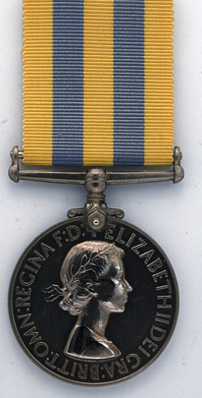
Arguments made AGAINST
Lasting trauma for those unsuited to it
Disruptive to lives
Expensive
Militarising young people
Life lessons can be taught in other ways
Notes:
NAM 1958-11-98-18
Korea Medal 1950-53.
The Korea Medal 1950-53 is a separate campaign medal awarded in addition to the General Service Medal 1918-62 for service in the Korean War (1950-1953). Struck in cupro-nickel, it bears the young Queen Elizabeth II’s head on the obverse and on the reverse a depiction of Hercules wrestling with the Hydra, with the word ‘Korea’ below.

Slide 13
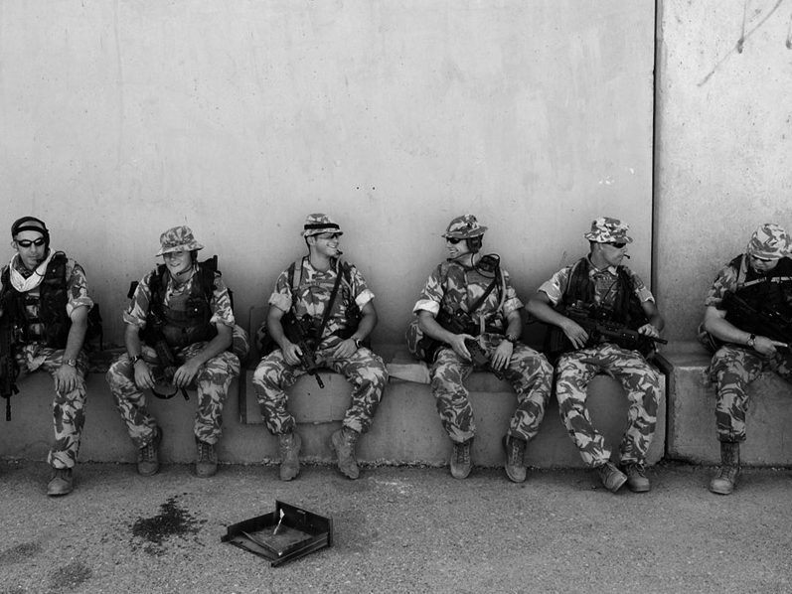
What argument would you make?
Notes:
NAM 2005-01-67-58
Digital photograph: Soldiers of 6 Platoon B Company call signs 30A and 30B (Three Zero Alpha and Bravo) take a short break whilst providing multiple patrols around the Local Government HQ Building in Basra to protect against possible attacks from militants, on what should have been the first day of Iraqi Independence.
Photographed by WO2 Giles Penfound, Army Media Operations, Basra, southern Iraq, Operation TELIC 4, 30 June 2004.
From a CD entitled 'Iraq Conflict. Operation Telic', compiled by WO2 Penfound, for an exhibition at the NAM provisionally entitled 'Portrait' (Project: Operation TELIC).
Associated with B Company 1st Battalion The Cheshire Regiment, Iraq (2003-).
The patrols started at 0645 in the morning and lasted for the whole day with soldiers supporting the local Iraqi police force. With the exception of normal criminal activity is was a very quiet day and failed to live up to the dire expectations of some. As a result of their aggressive and positive patrols the incidences of attacks on their base location dropped. The heat was a major problem to be tackled and it was important for the soldiers to constantly take on water to maintain their health and operational effectiveness.

Slide 14
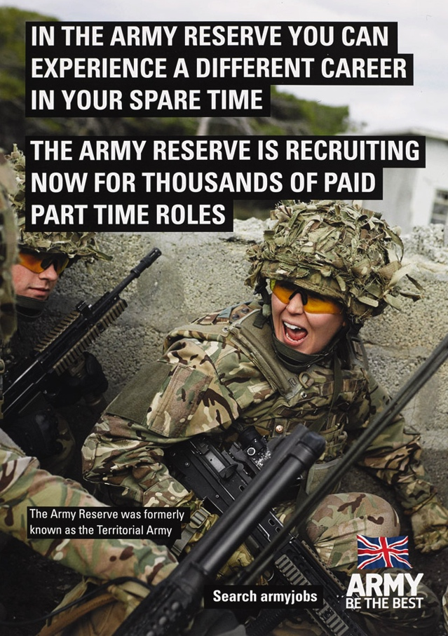
Professional or part-time?
The British Army is currently a volunteer force.
It is going through the process of reducing to a smaller professional full-time Army. There will be a bigger pool of part-time reservists who can be sent to fight alongside regular troops, but who return to their civilian lives in between.
But there are other countries that still use conscription.
Notes:
NAM. 2015-01-4-6
Army Reserve recruiting poster, 2014 (c).
Produced by the British Army Recruiting Group for the Ministry of Defence, 2014 (c).
Crown copyright.

Slide 15
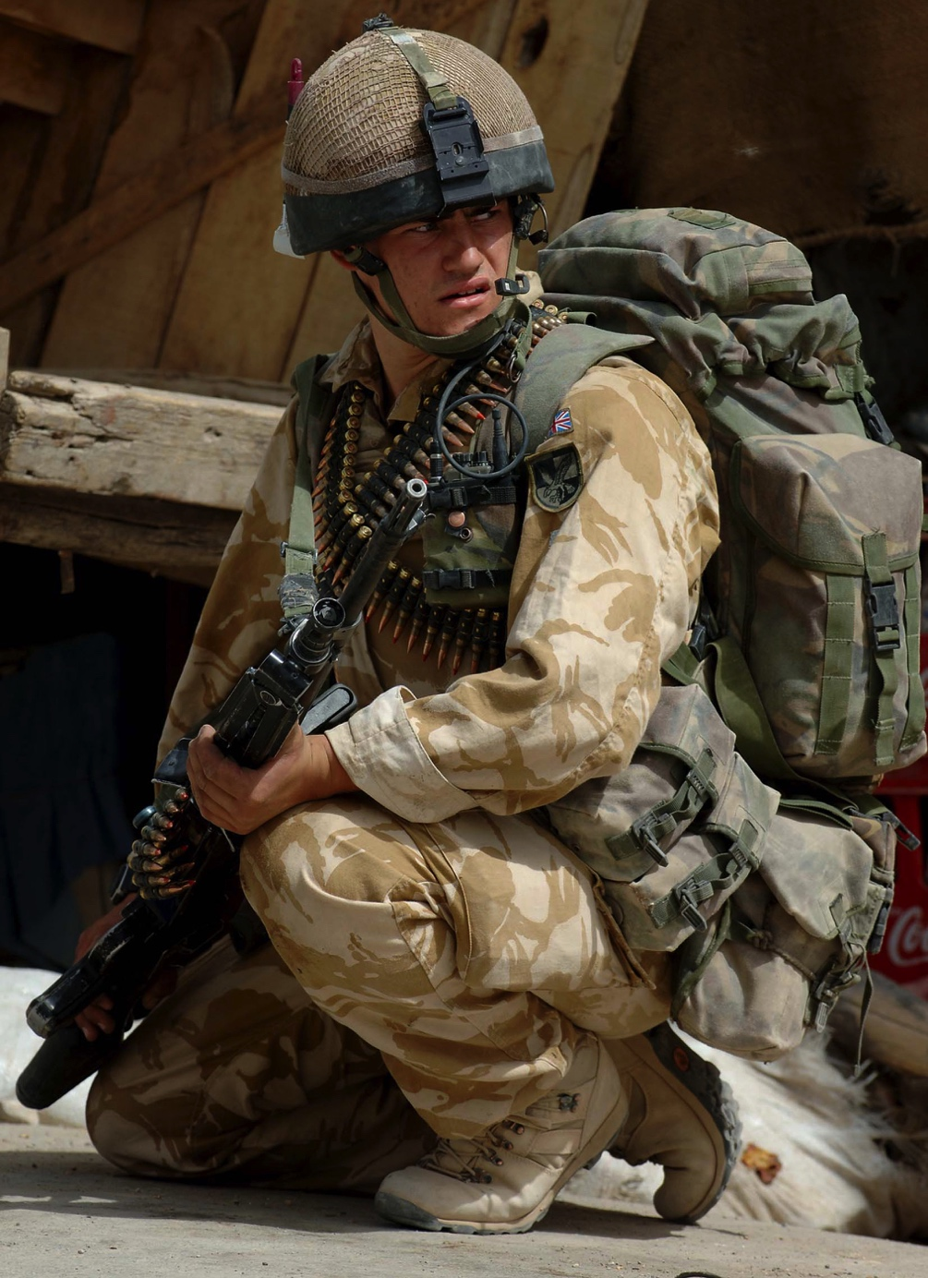
Why do other countries use conscription?
One point of view:
“There are currently two kinds of countries enforcing conscription. Those with a culture of militarism justified by a constant fear of war (like Israel) and those using it to mask other issues – high unemployment, for instance – like Greece.”
Source: www.telegraph.co.uk
Notes:
NAM. 2006-10-3-198
Photograph: A soldier from 3rd Battalion The Parachute Regiment, laden with link ammunition for his General Purpose Machine Gun, in Now Zad.
Digital photograph taken by Cpl Mike Fletcher, Royal Logistic Corps, Helmand Task Force Photographer, Now Zad, Helmand Province, Afghanistan, July 2006. From a CD of 309 images.
Crown copyright.
Members of the 3rd Battalion the Parachute Regiment, D Squadron Household Cavalry Regiment and other 16 Air Assault Brigade elements which make up the Helmand Task Force (HTF), on the 30th and 31st July 2006, carried out an operation in the Taliban strong hold town of Now Zad, Helmand Province, Afghanistan.
Troops hit the ground at first light on the 30th July having flown in on CH 47 (Chinook) helicopters and were met by D Sqn HCR and other support elements. B and C Coy marched straight into Now Zad town knowing it was a Taliban strong hold with many others in the area which could be called upon for assistance.
The HTF wanted take a strong hold in Now Zad and therefore bring security and stability to the area which had turned into a ghost town. This would show the local population that coalition forces were there to stay and Taliban rule would not return.
This image was taken on Operation HERRICK IV, the UK's deployment into Helmand Province, Southern Afghanistan. Operation HERRICK IV has seen the development of the Helmand Task Force in the province, which has seen the cross Governmental Provincial Reconstruction Team set up in Lashkar Gah to help the Afghan Government build strong governmental institutions, security and create jobs. The Task Force was made up of 3,300 troops from the British Military, with the majority being taken from 16 Air Assault Brigade.

Slide 16

Is there any situation which could justify the reintroduction of compulsory military service in the UK?
Notes:
NAM. 1995-01-148-1
Identity tag of Pte Alan Ball, Royal Army Ordnance Corps, National Service and Territorial Army, 1950-1959.

Slide 17

Compulsory National Service
In other countries, compulsory National Service can take the form of civilian service.
The nature of civilian service varies but may include, for example:
Working for a public service such as a hospital
Voluntary work
Some basic training such as first aid and non-violent resistance
Notes:
NAM 2007-10-8-45-76
Students from Tayforth University Officers Training Corps (UOTC) working in the Kamuli district of Uganda in support London based charity, The Busoga Trust.
Digital photograph, one of 467 images taken from two CDs of multimedia, by Cpl Paul Jarvis, Royal Logistic Corps, August 2003. Crown copyright.
Kamuli is a poor, rural district situated along the banks of the River Nile, some 3 hours from the capital Kampala. It is estimated that 60% of the local population do not have access to a clean water supply. Under the leadership of Captain Dave Balmer, three groups of students spent three weeks assisting in the construction of shallow wells, hand pumps and rainwater collection tanks situated close to local settlements.
The UOTC offers students the opportunity to see and experience life in the Army but the scheme does not commit a student to joining the Army after graduation.
From one of 96 CDs of photographs of the British Army on active service, training or engaged in sports, 2001-2005.

Slide 18
Take a view…
Is it right for your country to make you fight?
Notes:
NAM 1972-08-67-1-48
Stereoscopic photograph, Under cover of gas and smoke we break through to Serre and Thiepval (photo from captured prisoner), nd.
From a collection of one hundred and one stereoscopic photographs in box one of two entitled ‘The Great War’ including the official series.
Associated with World War One, Western Front (1914-1918).
Crown copyright.

